Slide 1


School District Management System
Sunnydale School District
SheQL
Empowering Schools. Connecting Communities. Driving Student Success.
Notes:
Ashley

Slide 2



Project Overview
The objective of our application is to help students, guardians, teachers, and district administrators efficiently track and manage academic performance within and across schools.
Operational Database
Analytical Database
Comprehensive platform for managing everyday school district operations
Delivers powerful insights for district administrators
Enables students to view courses, grades, and guardian information
Allows teachers to manage grades, view attendance, and communicate with guardians.
Empowers guardians to track student progress and contact teachers
Streamlines day-to-day educational workflows across the district
Provides school administrators with GPA and attendance overviews
Enables district administrators to compare performance across schools
Supports data-driven decisions for academic planning and resource allocation
Helps identify patterns in student achievement and school effectiveness
Notes:
Ashley

Slide 3





Data Source
Since real-world school district data is typically confidential, this project uses a carefully simulated dataset that mimics the essential characteristics of real educational environments.
Educationally Accurate
District Administrator
Grades, courses, and schedules reflect real-world patterns
Teacher
Complete Connections
Students, teachers, and classes are correctly interconnected
Student
Completely Synthetic
All sensitive data is randomly generated
Guardian
Notes:
Ashley

Slide 4
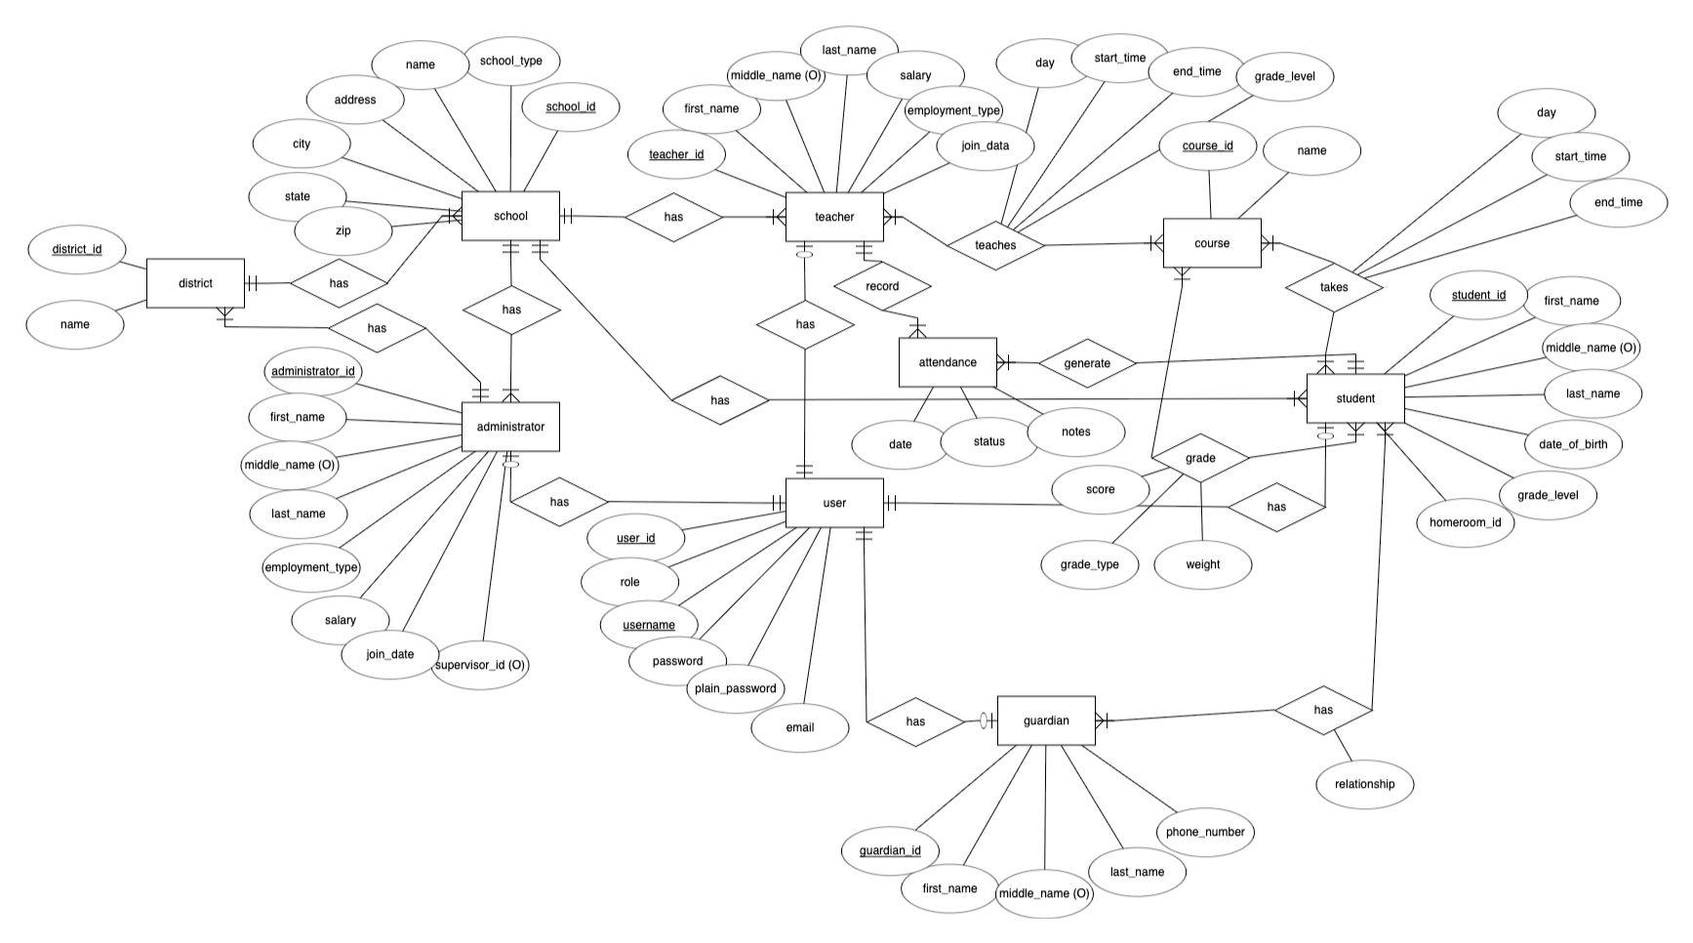
Database Design - ER Diagram
Notes:
Ashley

Slide 5
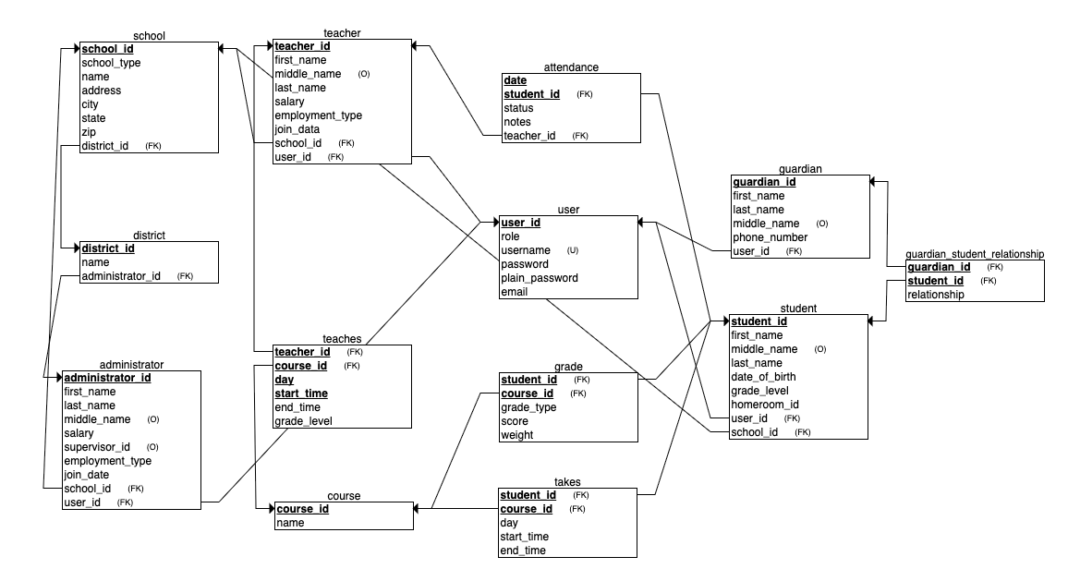
Database Design - Relational Schema
Notes:
Ashley

Slide 6
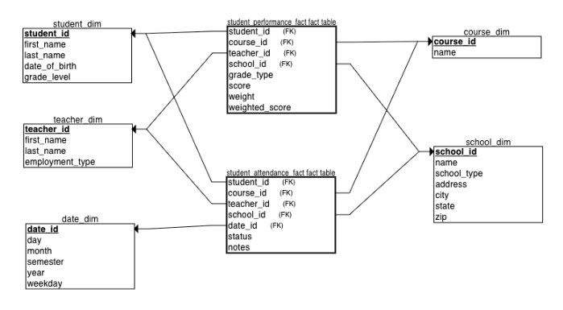
Analytical Design - Star Schema
Notes:
Louisa: student performance fact table allows for grade based analysis
student attendance fact table allows for attendance based analysis

Slide 7
ETL
Extract
Transform
Load
Data sourced from operational database
Tables:
student
teacher
course
school
grade_details
attendance
Modify data to use smaller data types
student_id: BIGINT ➞ INT
date_id: INT ➞ MEDIUMINT
zip: VARCHAR(20) ➞ CHAR(5)
grade_level: VARCHAR(20) ➞ TINYINT
Add aggregate weighted_score column
etl_control table included to monitor ETL attempts
Avoid duplicates by deleting existing rows in the analytical DB based on primary keys
Notes:
Louisa

Slide 8
Roles
1
2
3
4
Student
View homeroom
View courses schedule
View grades
View personal information
View guardian information
Teacher
View courses schedule
Show calendar
Manage grades
Manage attendance
Add or edit grades
end message to guardians
View Analytics
Guardian
View student’s grades
View their student’s attendance
Send message to teacher
District
Administrator
Show average GPA
Show attendance by school
Show number of teachers and students
Notes:
Louisa

Slide 9
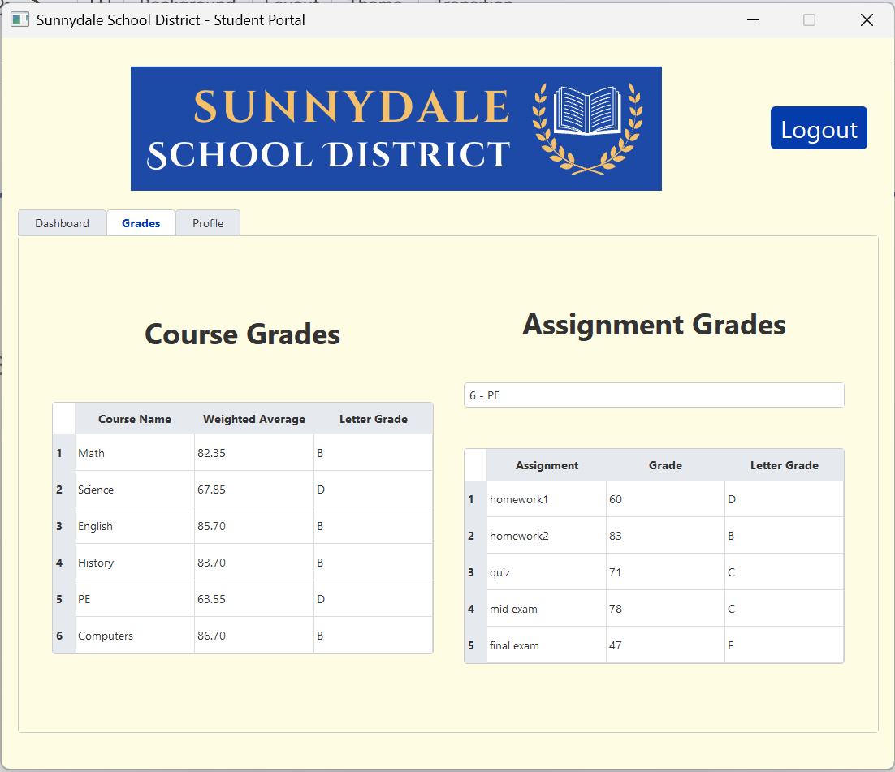
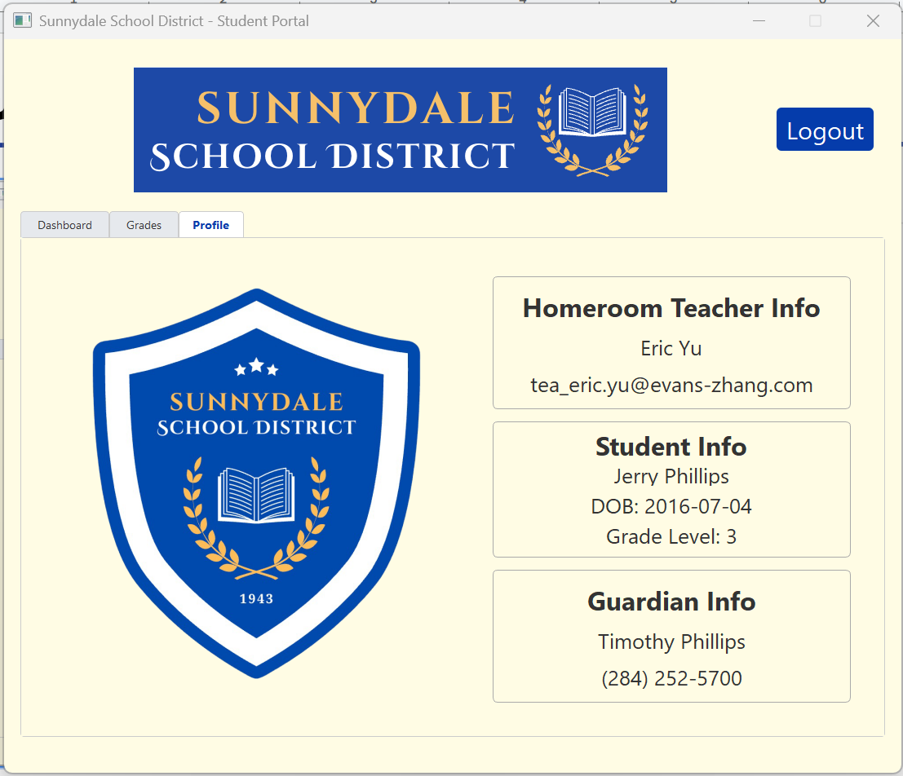
User Interface Scenarios
Student Portal
Check Overall Grades
See Personal Information
Notes:
Louisa

Slide 10
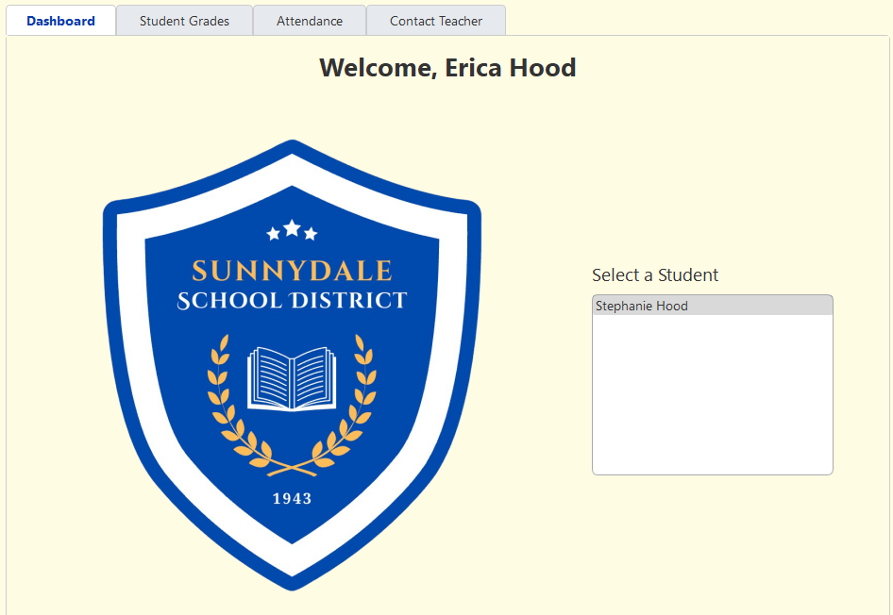
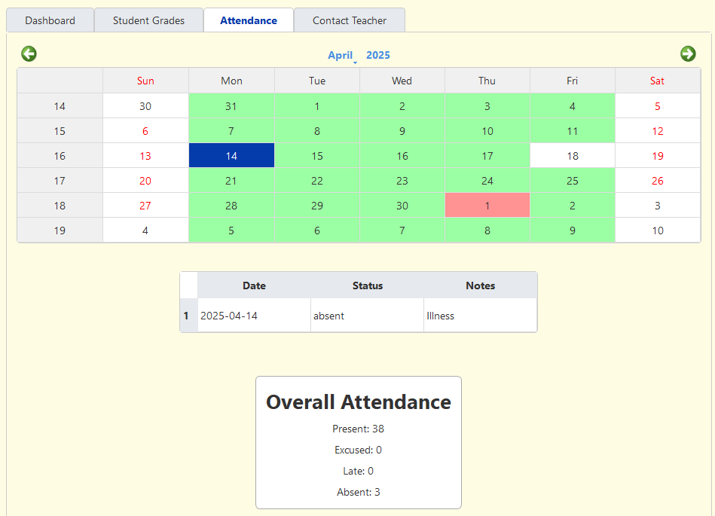
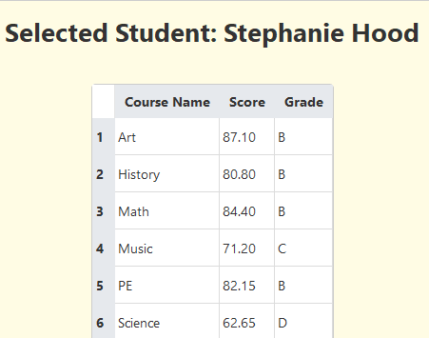
User Interface Scenarios
Guardian Portal
Check Overall Grades
Get Attendance Record
Notes:
Benita

Slide 11
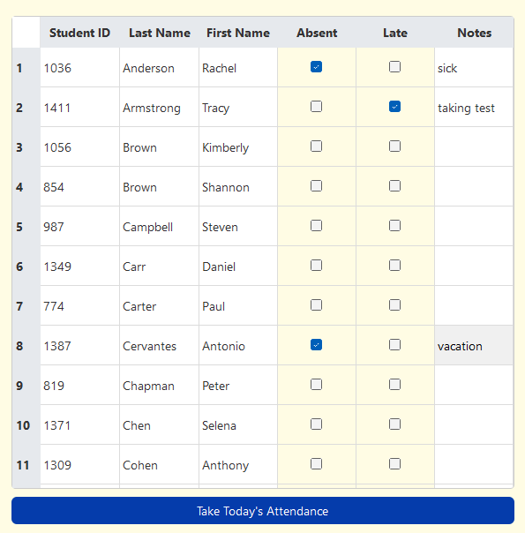
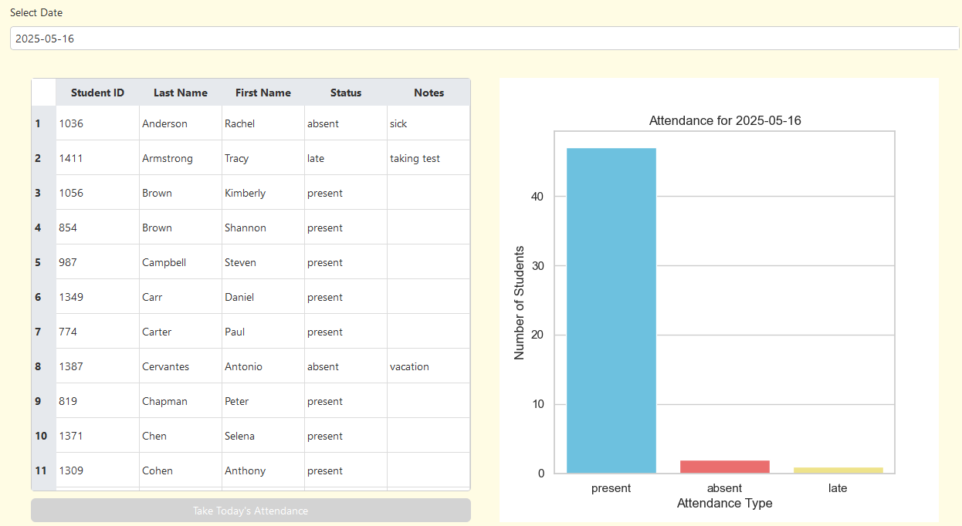
User Interface Scenarios
Teacher Portal
Record Attendance

Slide 12
Demo
SheQL
Empowering Schools. Connecting Communities. Driving Student Success.

